Slide 1
DIALYSIS HEALTHCARE ANALYTICS
Group 6 Members
Anmol Yadav
Shivani Didore
Ashwini Parmar
Rahul Sharma
Sanjay R

Slide 2
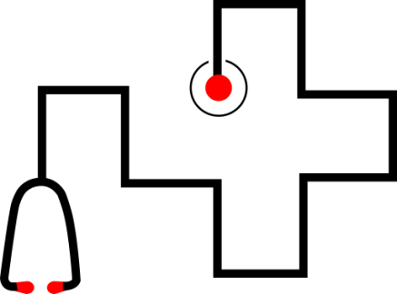
Agenda
01
The main goal of a dialysis analytics project is to leverage
data-driven insights to enhance patient care, improve
outcomes, optimize resource utilization, and drive
continuous improvement in the field of dialysis treatment.
02
Dialysis healthcare analysis is based on 6 Key Performance Indicators(KPI’s) to gain insights and make data-driven decisions in the field of dialysis care.
03
It includes monitoring number of patients across various summaries, comparing profit Vs. Non profit statistics, Chain organizations based on the total score , analyzing dialysis stations statistics, analyzing category text for expected category and tracking the average payment reduction rate.

Slide 3

DaVita's Dominance in the Dialysis Sector
1. Observation:
2. Suggestion:
3. Conclusion:
DaVita leads the dialysis healthcare sector with the highest number of stations 50k+ in the USA.
Notably, DaVita exhibits significant dominance in California, with 7,719 dialysis stations, showcasing a stronghold compared to other states.
Research the factors behind DaVita's extensive station network. Investigate operational strategies, patient care models, or partnerships to extract best practices for improving other organizations' station networks.
DaVita's widespread presence implies effective management strategies and operational excellence in the dialysis sector.
Studying DaVita's methods could potentially benefit other organizations in enhancing their station networks and overall patient care.

Slide 4
Profit vs. Non-Profit Distribution in Healthcare Organization
1. Observation:
2. Suggestion:
3. Conclusion:
California (CA) notably hosts significant Profit (623) and Non-Profit (107) healthcare projects. Non-Profit ventures spread widely among chains like Independent Dialysis Foundations, Dialysis Clinic, Inc., and Satellite Healthcare.
Non-Profit ventures (869) are diversified among chains, while Profit ventures (6854) primarily concentrate in DaVita and Fresenius Medical Care.
Investigate why Profit ventures dominate specific chains, contrasting with Non-Profit preferences in others.
Evaluate Profit vs. Non-Profit strategies on patient care and operations within these chains.
Coexistence of Profit and Non-Profit ventures across chains showcases healthcare sector diversity.
Studying Profit vs. Non-Profit dynamics offers valuable insights into operational and care strategies.
Type | Count for CA
Non-Profit | 107
Profit | 623
Grand Total | 730

Slide 5
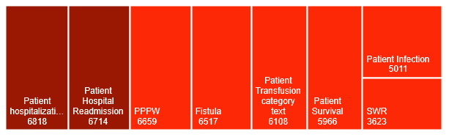
Hospitalization in the No of Category Text
1. Observation:
2. Suggestion:
3. Conclusion:
Analyzing the # of category text, such as patient classification or other relevant criteria, is an important KPI in dialysis healthcare analytics.
Patient Hospitalization in the dialysis health care with the highest number of As Expect 6,818.
Consider organizing the text related to “Hospitalization” into categories such as Admission Notes, Discharge Summaries, and Medical Updates.
This categorization can enhance data management and facilitate more structured analysis within the health care.
To optimize the health care, establish clear categories of text related to the “Hospitalization”. This structured approach enhances organization, aiding in efficient data management and comprehensive analysis.

Slide 6
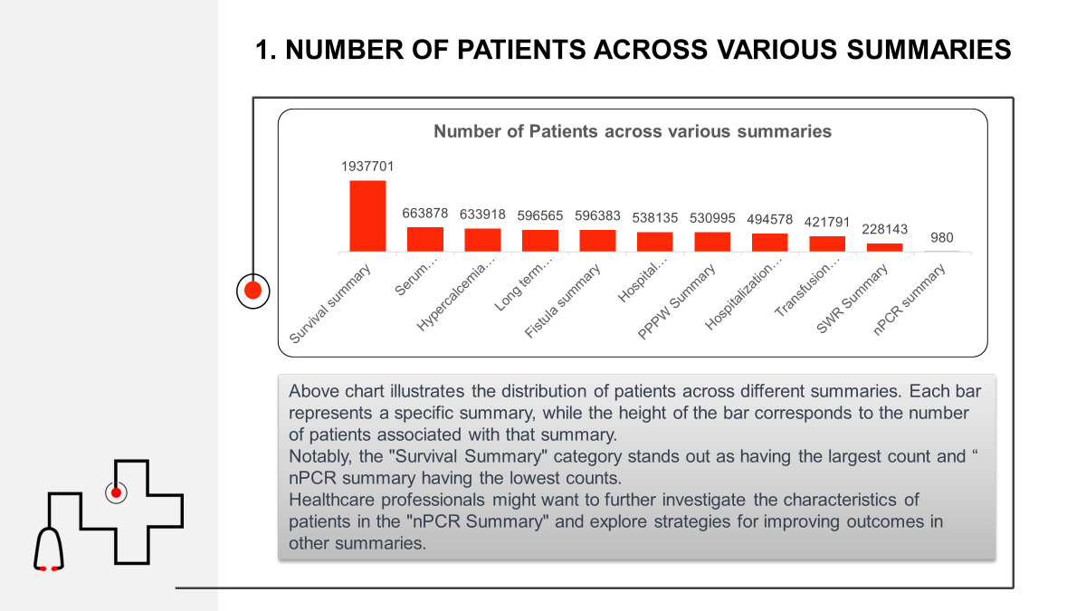

Slide 7
Chain Organizations w.r.t. Total Performance Score as No Score
The analysis of the bar graph highlights the widespread occurrence of "No Score" performances among the top five Chain Organizations, with Davita having the highest count and US Renal Care having the lowest.
"No Score" may indicate challenges in obtaining or reporting relevant performance data.
Further investigation is essential to determine the root causes behind the lack of performance scores.
Organizations with "No Score" should work on improving their data

Slide 8

Average Payment Reduction Rate
Observation:
Analyze trends in the Average Payment Reduction Rate over time. Consider whether the rate is increasing, decreasing, or remaining stable. Identifying trends helps in understanding the effectiveness of strategies implemented to negotiate or reduce payments. The observed Average Payment Reduction Rate of 0.30% in the dialysis healthcare dashboard indicates a relatively low level of reduction in payments for the services provided.
Suggestion:
While the current reduction rate is low, there may still be opportunities to explore additional cost-saving initiatives. This could involve negotiating better rates with vendors, optimizing resource allocation, or identifying inefficiencies in the current operational processes.
Conclusion:
The project has implemented effective strategies to control payments without significantly impacting the overall financial structure. However, there is always room for continuous improvement, and proactive measures such as exploring new cost-saving initiatives and monitoring trends over time can contribute to the effective management.
Average Payment Reduction Rate
0.30%

Slide 9
Thank you

